Slide 1
WHAT ARE HUMAN RIGHTS?

Slide 2
WHO DECIDES THESE RIGHTS????
GOVERNMENTS?
PARENTS?
THE UNITED NATIONS?
RELIGIONS?
ALL OF THESE?

Slide 3
UNIVERSAL
DECLARATION
OF HUMAN RIGHTS
was proclaimed by the United Nations General Assembly
10 December 1948

Slide 4
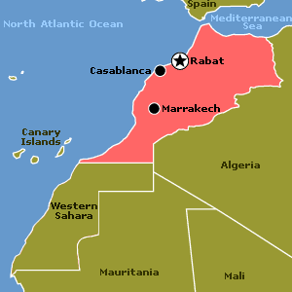
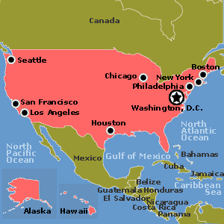
Which countries are members of the United Nations???
WE ARE!

Slide 5
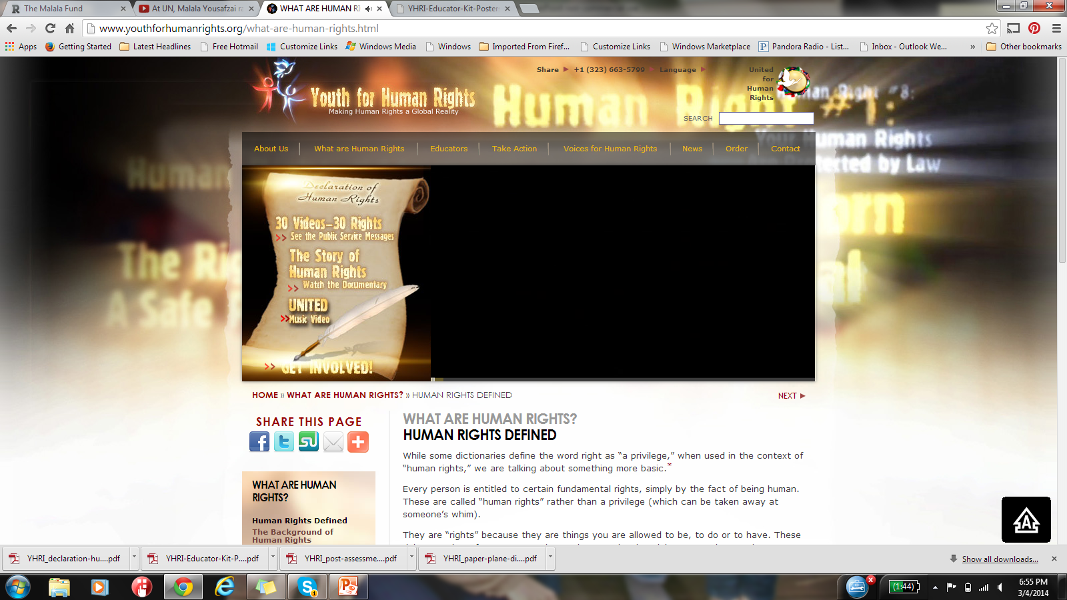

Slide 6
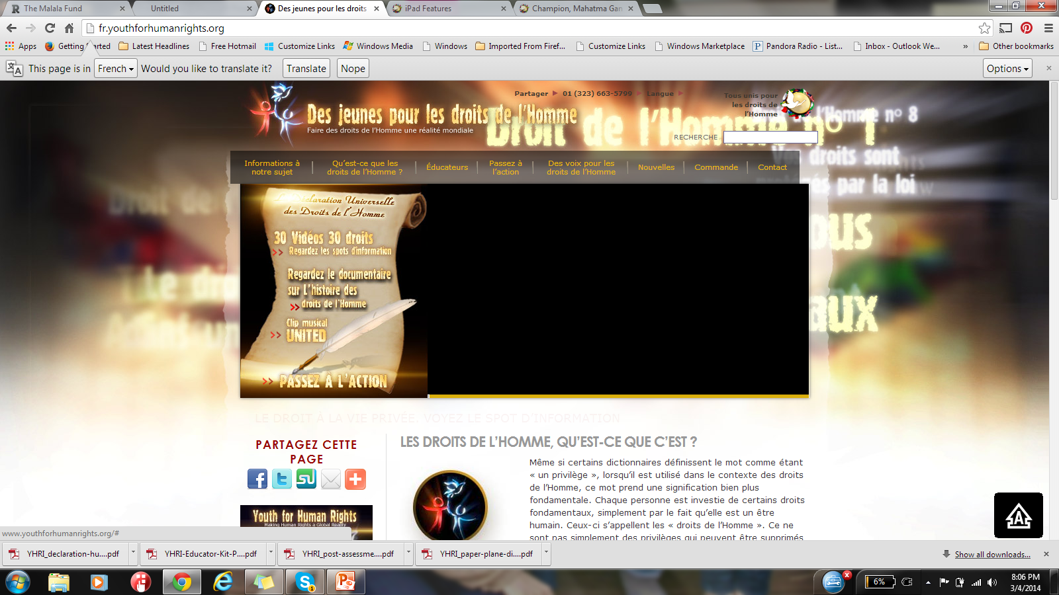
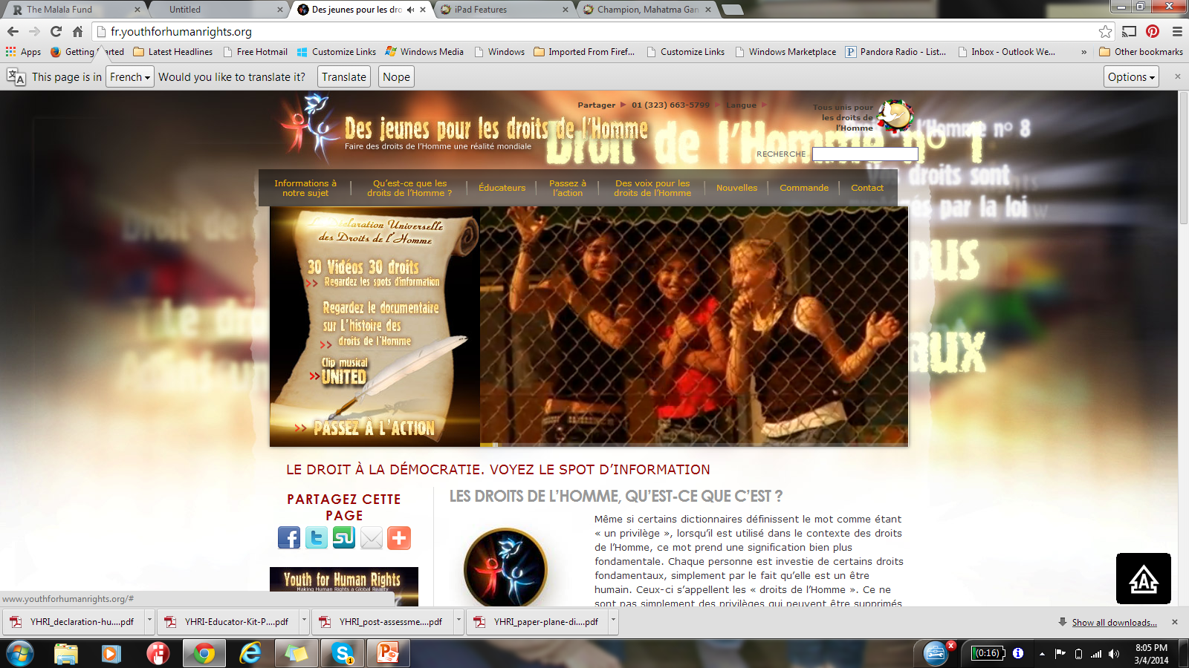

Slide 7
We Are All Born Free & Equal
Don't Discriminate
No Slavery
No Torture
The Right to Education

Slide 8
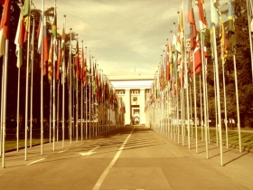
CHAMPIONS OF HUMAN RIGHTS……….

Slide 9
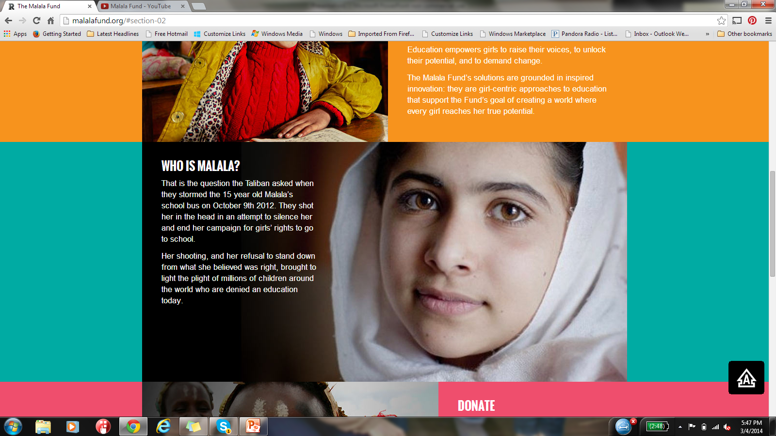
MALALA

Slide 10
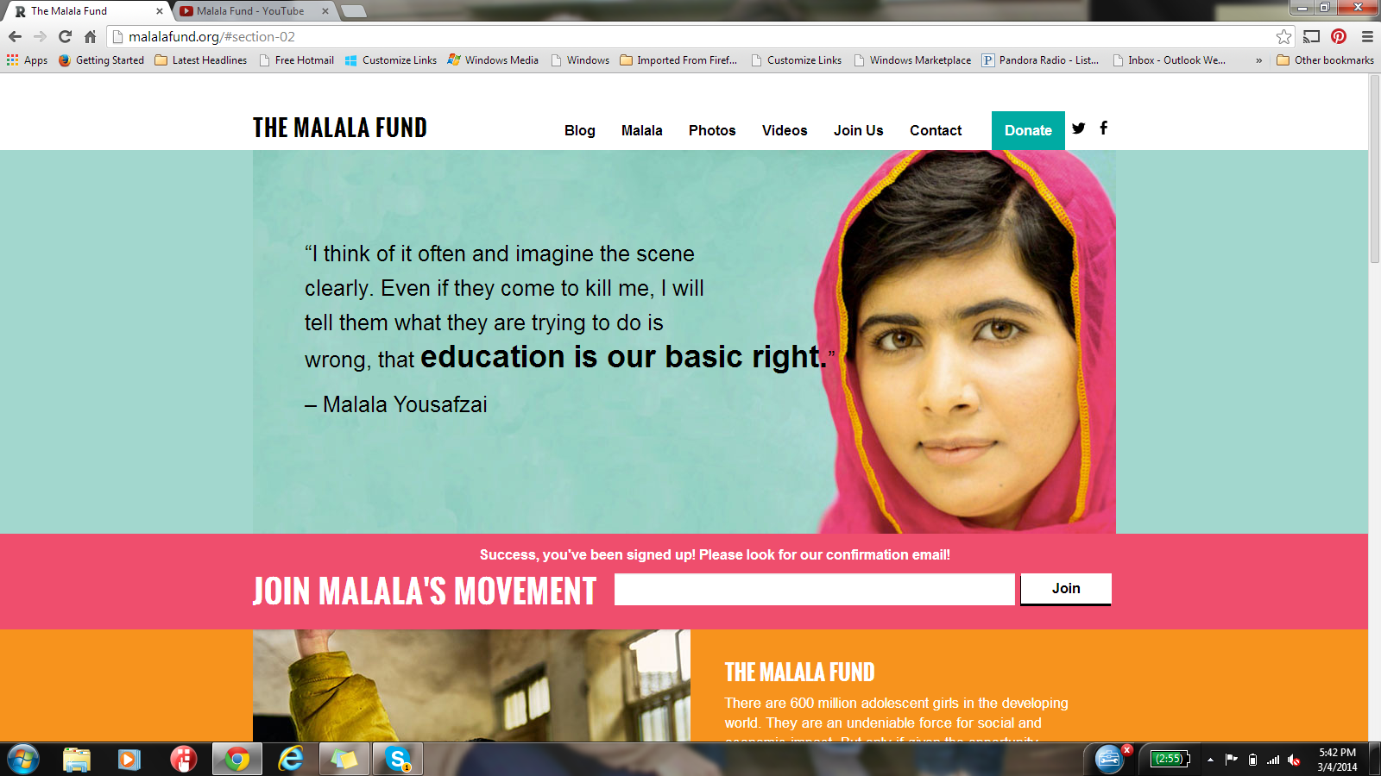

Slide 11
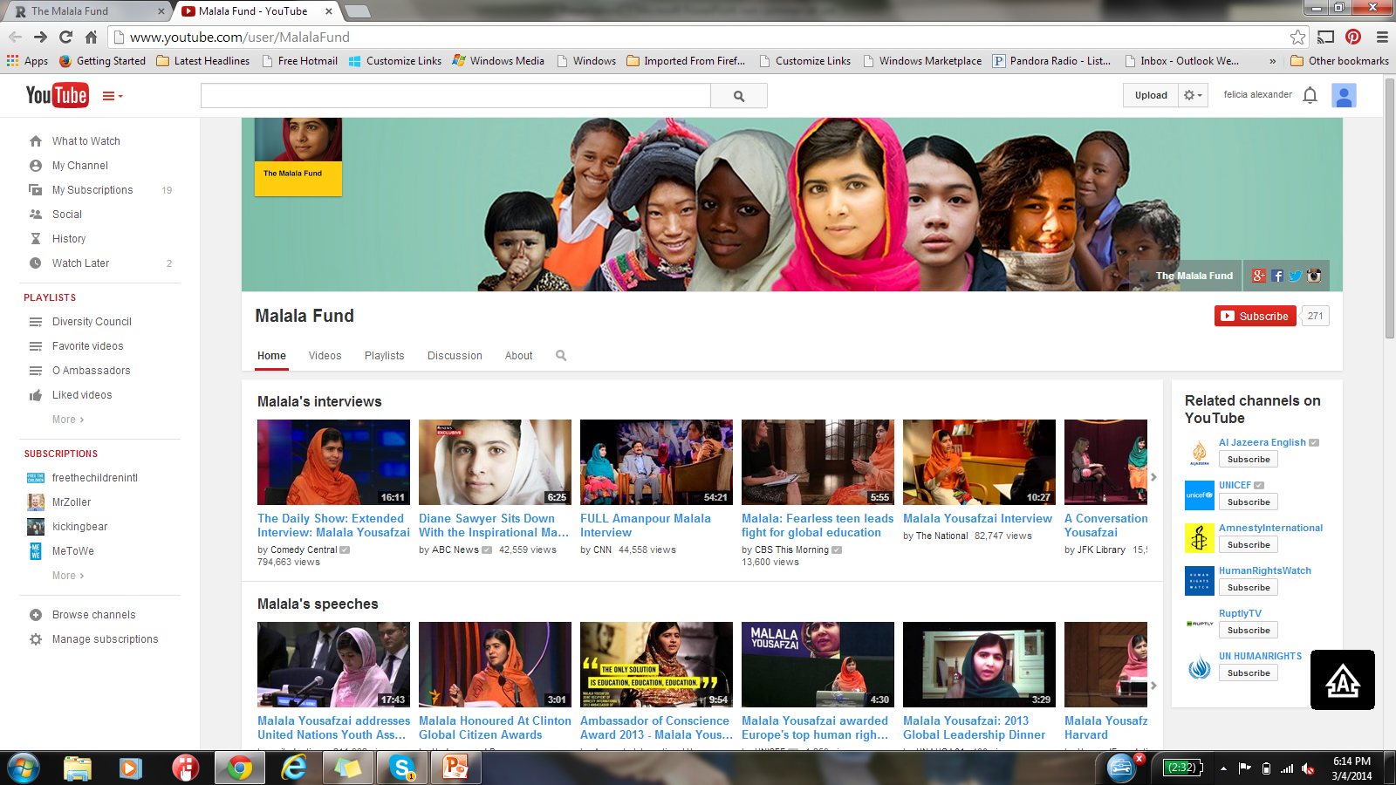
MALALA SPEAKS FOR GIRLS AROUND THE WORLD

Slide 12
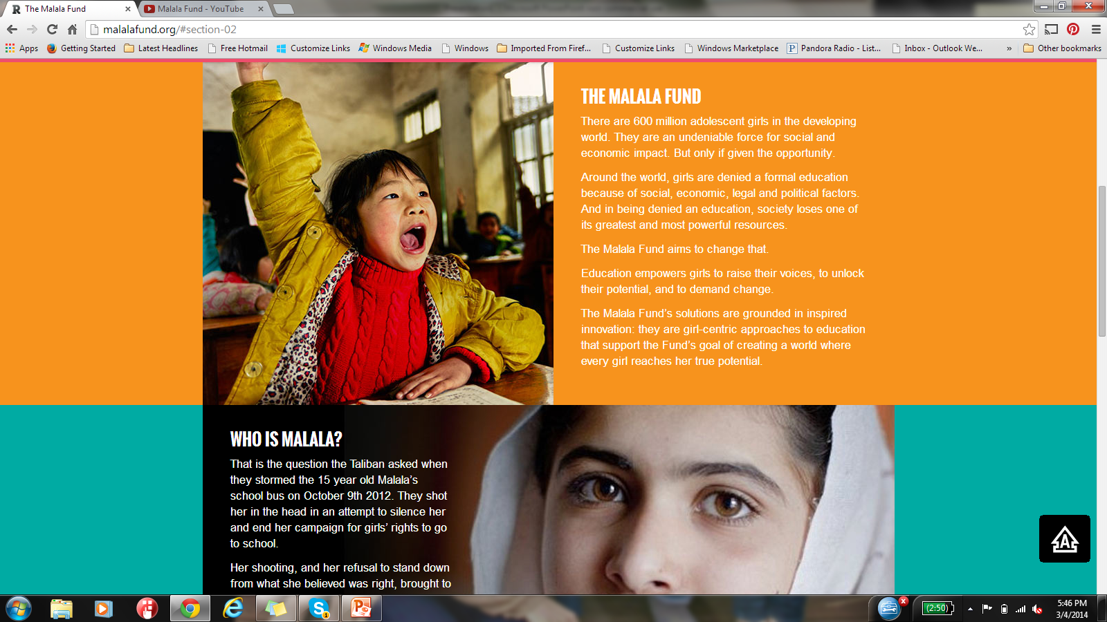
GIRLS EDUCATION

Slide 13
Champions of Human Rights
Mahatma Gandhi (India)
Eleanor Roosevelt (USA)
César Chávez (USA)
Nelson Mandela (So. Africa)
Martin Luther King, Jr. (USA)
Desmond Tutu (So. Africa)
Oscar Arias Sánchez (Costa Rica)
Muhammad Yunus (Bangladesh)
Daw Aung San Suu Kyi (Myanmar)
José Ramos-Horta (Timor-Leste)

Slide 14
How will YOU make your world better???

